Slide 1
Chapter XIII
Character Animation

Slide 2
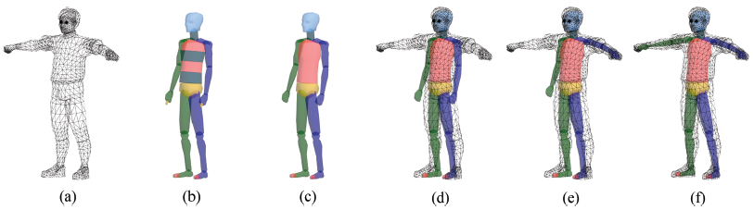
Skeleton
The most popular method to animate a character is to use a skeleton. It is an instance of an articulated body and is composed of a set of connected rigid components, bones.
  The initial pose of a character is called the default pose. See (a).
  3ds Max provides a few skeleton template named ‘biped.’ See (b).
  Such a template can be edited. See (c).
  The skeleton is embedded into the character mesh. See (d).
  It is then made to fit to the default pose. See (e) and (f).
The bones are depicted as if they were solids. However, they are not. When the skeleton is made to fit to the default pose, a matrix is computed per bone.
13-<number>

Slide 3
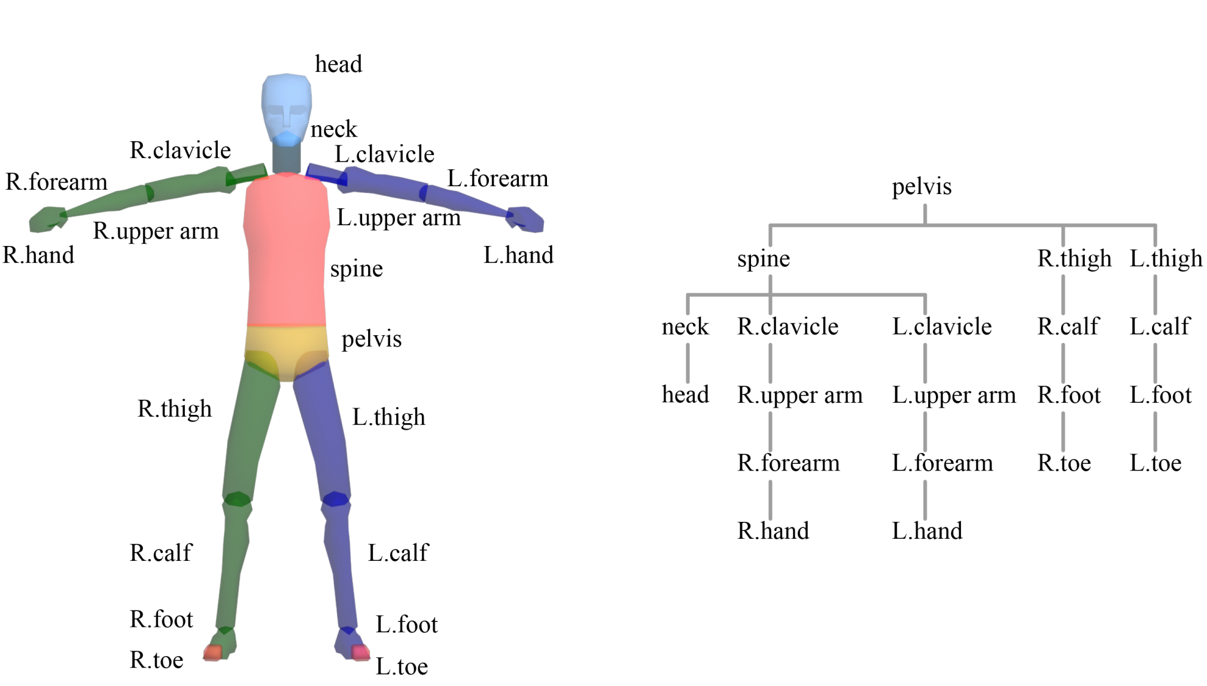
Skeleton (cont’d)
Skeletal hierarchy
13-<number>

Slide 4
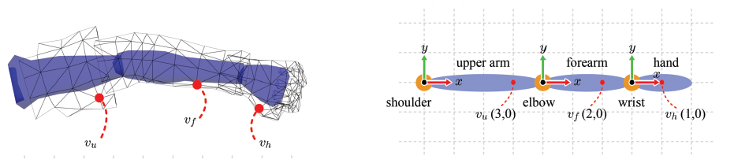
Space Change between Bones
The bones are connected at joints, which allow the rigid skeleton to animate in an articulated fashion. See the example, which consists of three bones (upper arm, forearm, and hand) and three joints (shoulder, elbow, and wrist).
When the forearm moves, for example, v_{f} has to move accordingly. It is simply achieved if v_{f} is defined in the forearm's object space.
Initially, all vertices of the default pose are defined in the object space of the character. To avoid confusion with the object space of a bone, let’s simply call the character’s object space character space.
Every character-space vertex of the default pose needs to be transformed into the object space of the bone (which we call bone space henceforth) it belongs to. For example, v_{f} will be transformed into the forearm's bone space so as to have the coordinates (2,0).
13-<number>

Slide 5
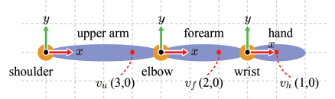




Space Change between Bones (cont’d)
For now, consider the opposite direction, i.e., from the bone space to the character space. If we can compute such a bone-to-character transform, its inverse can be used to convert a character-space vertex into the bone space.
Consider the to-parent transform of the forearm, which transforms a forearm vertex to the space of its parent.
Now consider the to-parent matrix of the hand.
Given a vertex at a bone, we can concatenate the to-parent matrices so as to transform the vertex into the bone space of any ancestor in the skeleton.
13-<number>

Slide 6
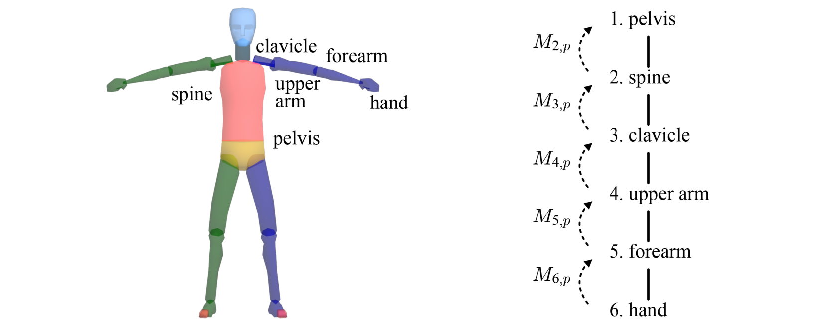
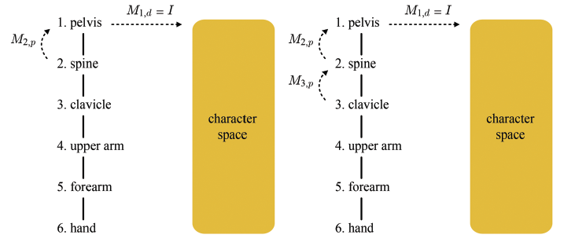


Character Space to Bone Space
The to-parent matrix is denoted by M_{i,p}.
Let us denote the transform from the bone space to the character space by M_{i,d}, where d stands for default pose.
M_{1,d}=I.
The spine’s transform to the character space:
The clavicle’s transform to the character space:
Let’s generalize
13-<number>

Slide 7
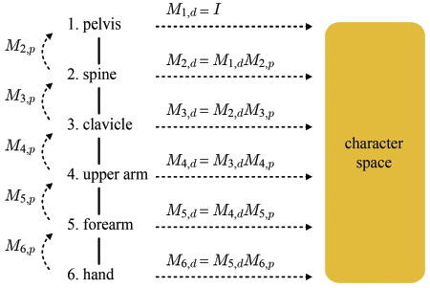

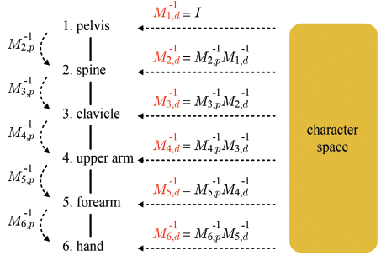
Character Space to Bone Space (cont’d)
So far, we have considered the transform from the bone space to the character space. However, what is needed in an articulated-body animation is its inverse.
Given the default pose, the to-parent transform of each bone, M_{i,p}, is immediately determined, and so is its inverse, M_{i,p}⁻¹.
Computing M_{i,d}⁻¹ requires M_{i-1,d}⁻¹ to be computed in advance.
We can compute M_{i,d}⁻¹ for every bone through the top-down traversal of the skeleton hierarchy.
13-<number>

Slide 8
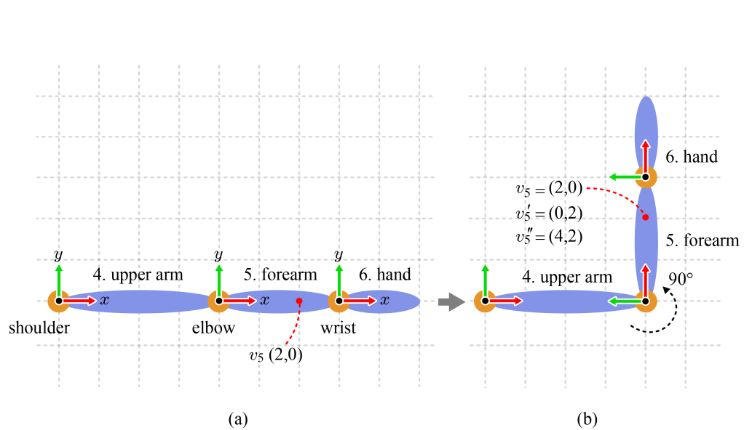
Forward Kinematics
We have identified the transform that converts a character-space vertex “in the default pose” to the i-th bone's space.
Now the i-th bone is animated. Then, the vertices belonging to the bone are accordingly animated.
For rendering, the animated vertices should be transformed back to the character space. (Then, they will be transformed to the world space, camera space and so forth, along the pipeline.)
Let us compute the matrix for animating v₅ and transforming it back to the character space. We name the matrix M_{5,a}.
13-<number>

Slide 9
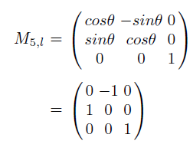
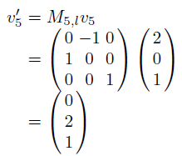
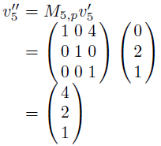

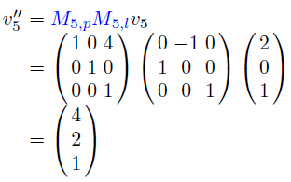

Forward Kinematics (cont’d)
Consider the forearm’s local transform M_{5,l}. It is applied to v₅. Whereas v₅ is fixed to (2,0), v₅´ represents the coordinates with respect to the original bone space of the forearm “before rotation.”
The bone spaces of the upper arm and forearm “before rotation” are related by the to-parent matrix M_{5,p} and therefore the coordinates of v₅´ “in the upper arm’s space” are computed using M_{5,p}.
13-<number>

Slide 10

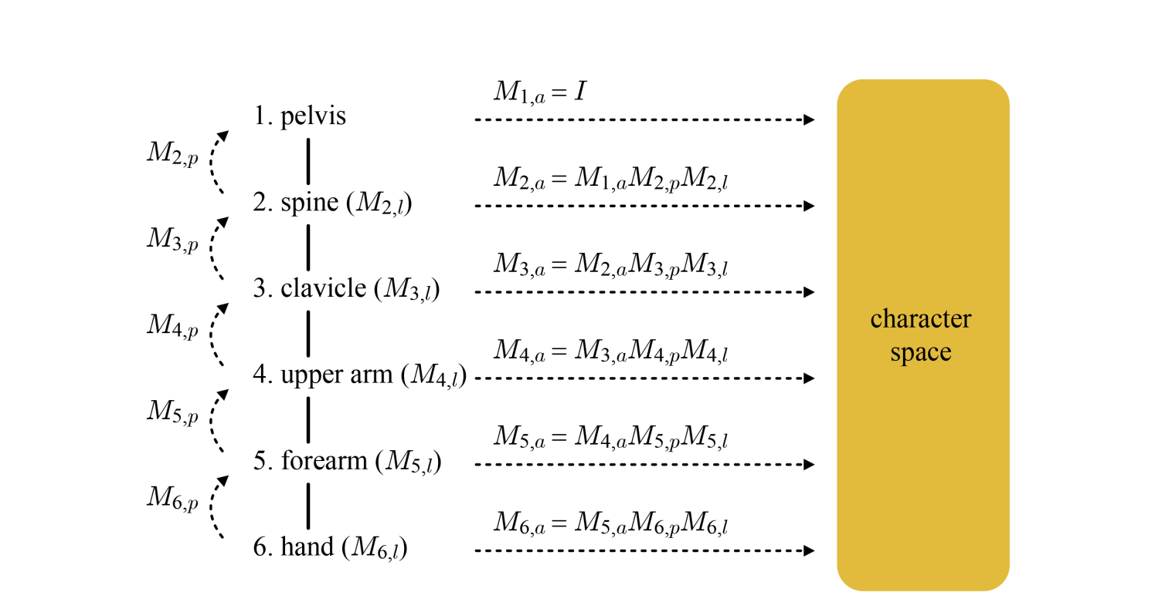
Forward Kinematics (cont’d)
We obtained the coordinates of “animated v₅” in the upper arm’s space.
The upper arm can also be animated. Let M_{4,a} denote the matrix that animates the upper arm’s vertex and transforms it into the character space.
Then, M_{5,a} is defined in terms of M_{4,a} together with M_{5,p}M_{5,l}.
It is generalized as follows:
13-<number>

Slide 11
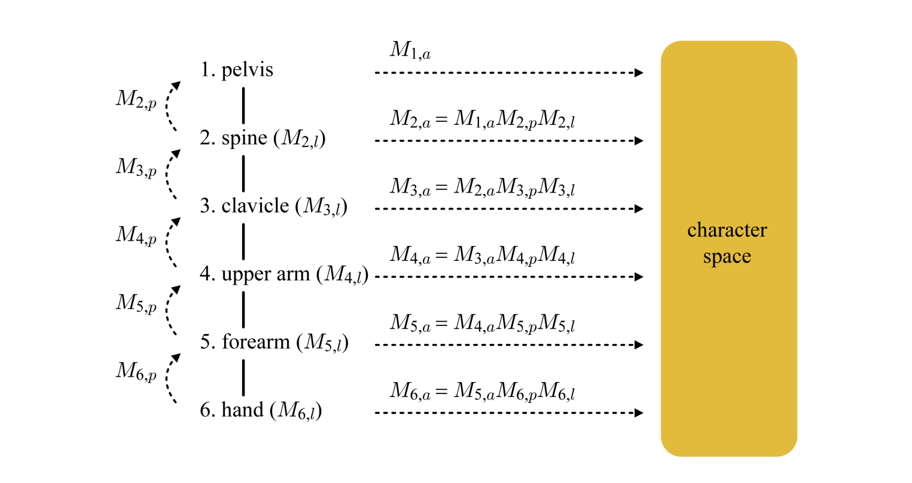
Forward Kinematics (cont’d)
When the artist defines the animated pose of the i-th bone, M_{i,l} is obtained.
M_{i,p} was obtained from the default pose.
So, computing M_{i,a} simply requires M_{i-1,a} to be computed in advance.
M_{1,a} representing the pose of the animated pelvis is defined by the artist.
We can compute the character transforms of all bones “in the animated pose” also in the top-down fashion.
When v_{d} and v_{a} denote the character-space vertices “in the default pose” and “in the animated pose,” respectively, we have the relation:
13-<number>

Slide 12
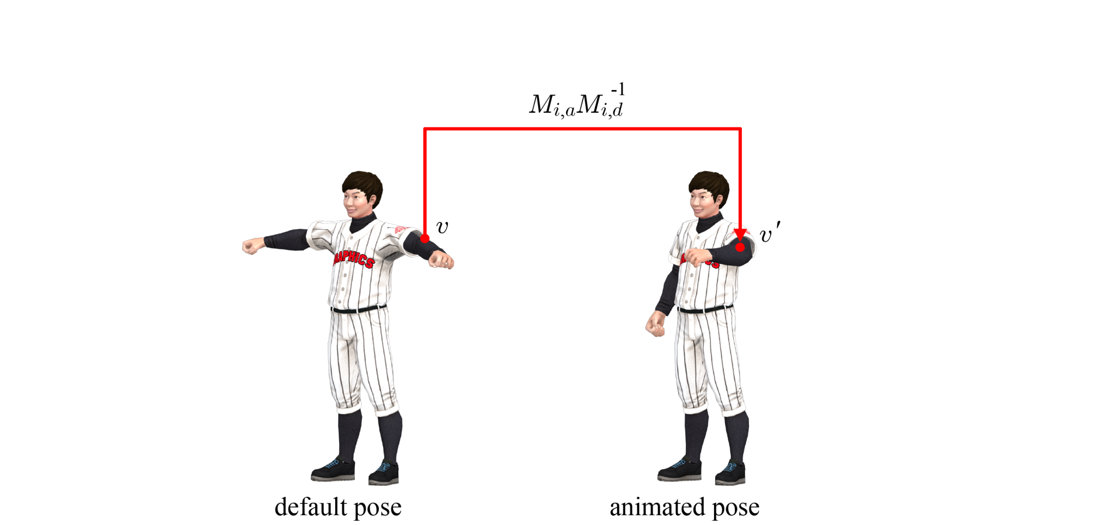
Forward Kinematics (cont’d)
A character-space vertex in the default pose, which we denote by v, is transformed to the bone space by M_{i-1,d}⁻¹ . Then, it is animated and transformed back to the character space by M_{i,a}.
13-<number>

Slide 13
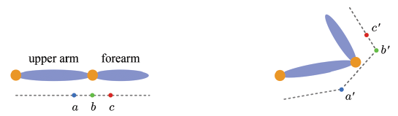
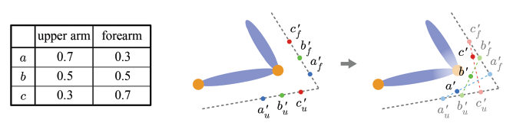
Skinning
Suppose that vertex a belongs to the upper arm whereas b and c belong to the forearm. Fig. Then, the deformed skin is not smooth.
The problem can be alleviated by making multiple bones affect a vertex and then blending the results, instead of binding a vertex to a single bone.
13-<number>

Slide 14
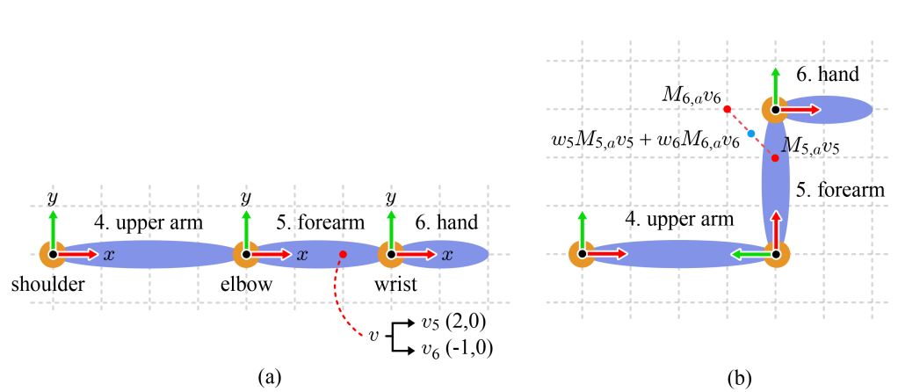






Skinning (cont’d)
Consider the weights, w₅ and w₆.
13-<number>

Slide 15
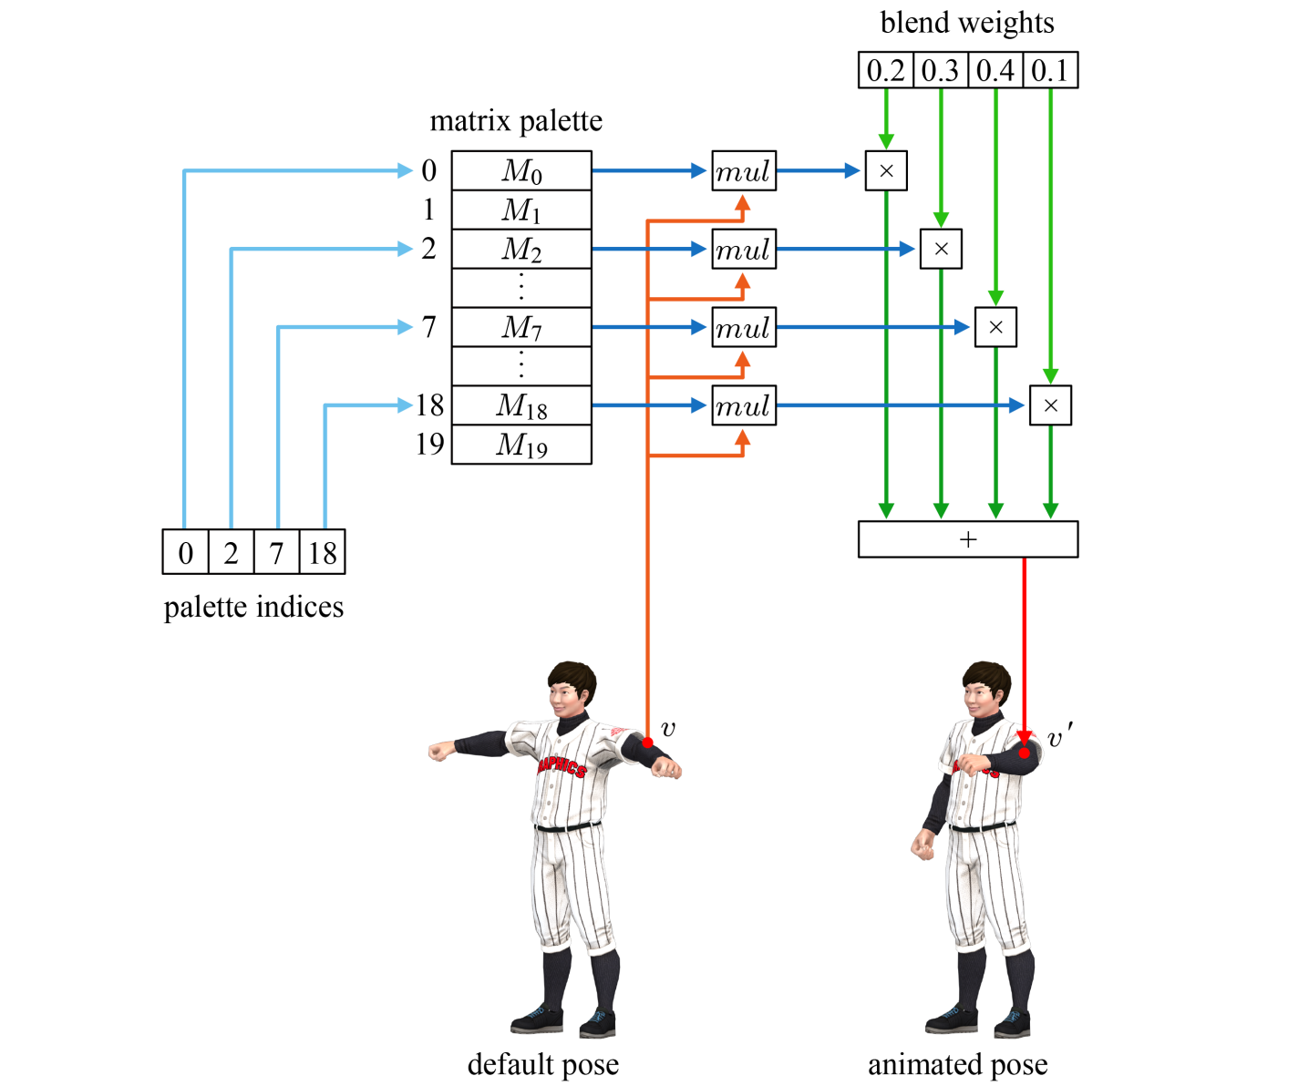
Skinning (cont’d)
In real-time 3D applications such as games, m is typically limited to four for programming efficiency.
13-<number>

Slide 16
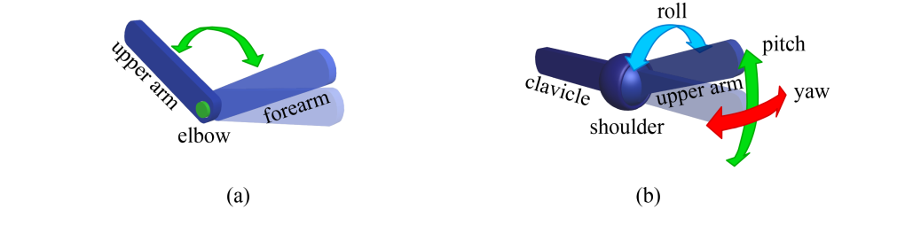
Inverse Kinematics
In robotics, an end effector refers to the device located at the end of a robotic arm.
Forward kinematics computes the pose of the end effector as a function of the joint angles of the robotic arm.
The reverse process is called inverse kinematics (IK). Given the desired pose of the end effector along with the initial pose of the robotic arm, the joint angles of the final pose are calculated.
The number of independent variables defining the state of an object is called the degrees of freedom (DOF).
13-<number>

Slide 17
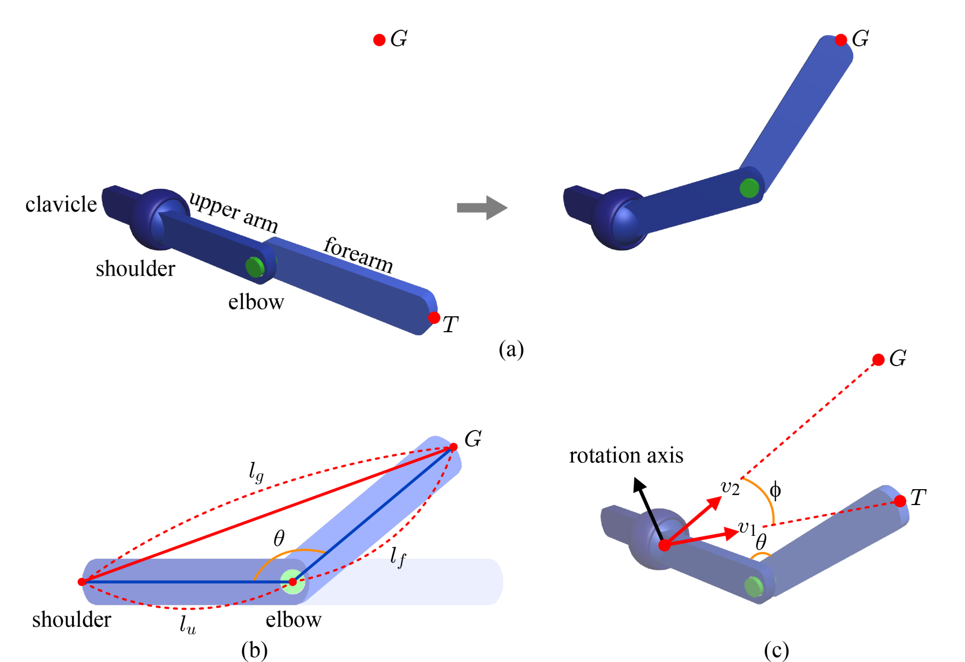


Inverse Kinematics - Analytic Solution
13-<number>

Slide 18
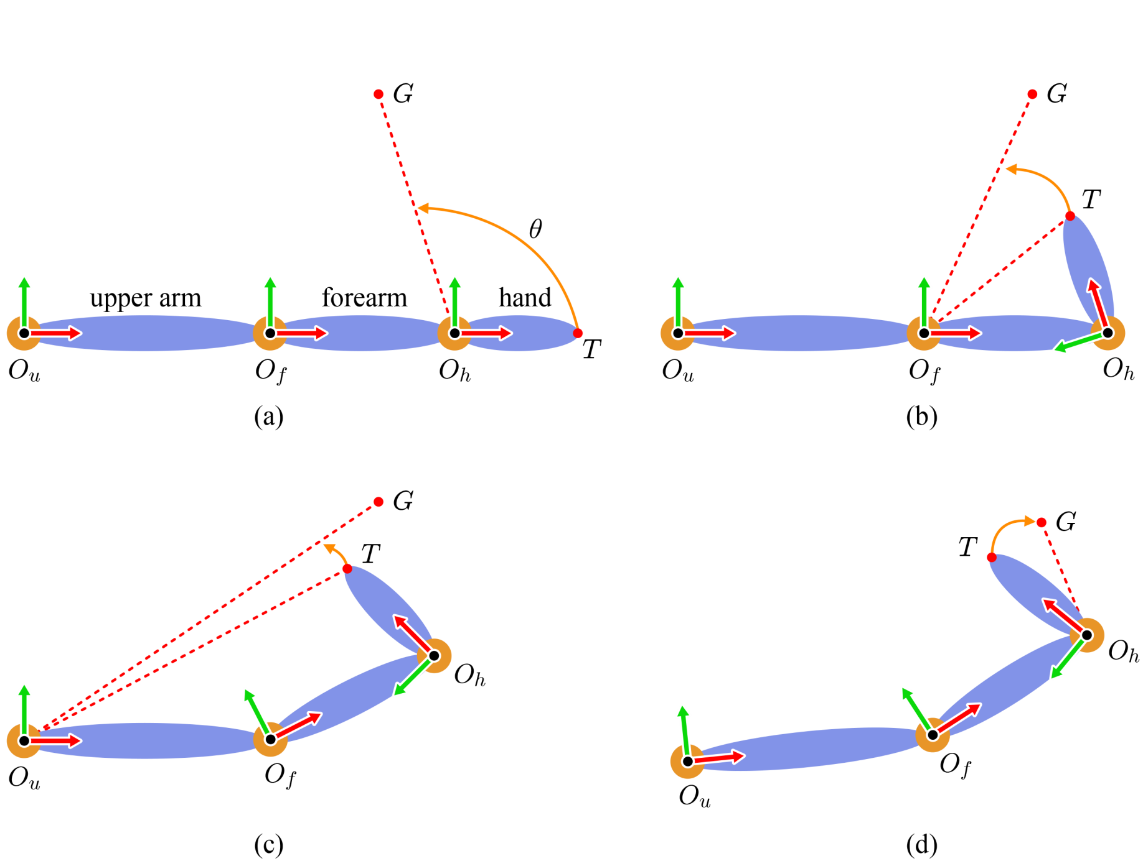
Inverse Kinematics - Cyclic Coordinate Descent
13-<number>

Slide 19
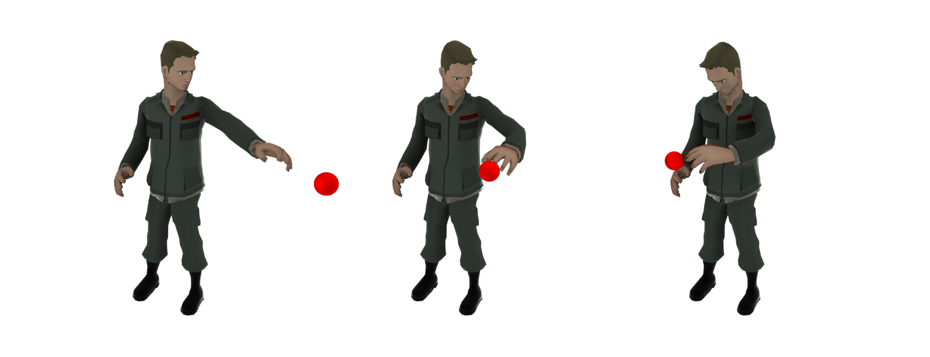
Inverse Kinematics - Example
13-<number>

